Slide 1
My god is so BIG so strong and so mighty there’s nothing MY GOD cannot do for you
MY GOD IS SO BIG

Slide 2
Big : lớn strong: mạnh Mighty: vĩ đại, hùng mạnh nothing: không có gì cannot: không thể can: có thể do: làm There: ở đó My: Của tôi So: vì thế lưu ý ‘so’ trong trường hợp này có nghĩa là đến 1 mức độ lớn như thế ( such a great extend )

Slide 3
The rivers are his the mountains are his the stars are his handiwork too

Slide 4
River: sông mountain: núi star:ngôi sao handiwork: làm bằng tay

Slide 5
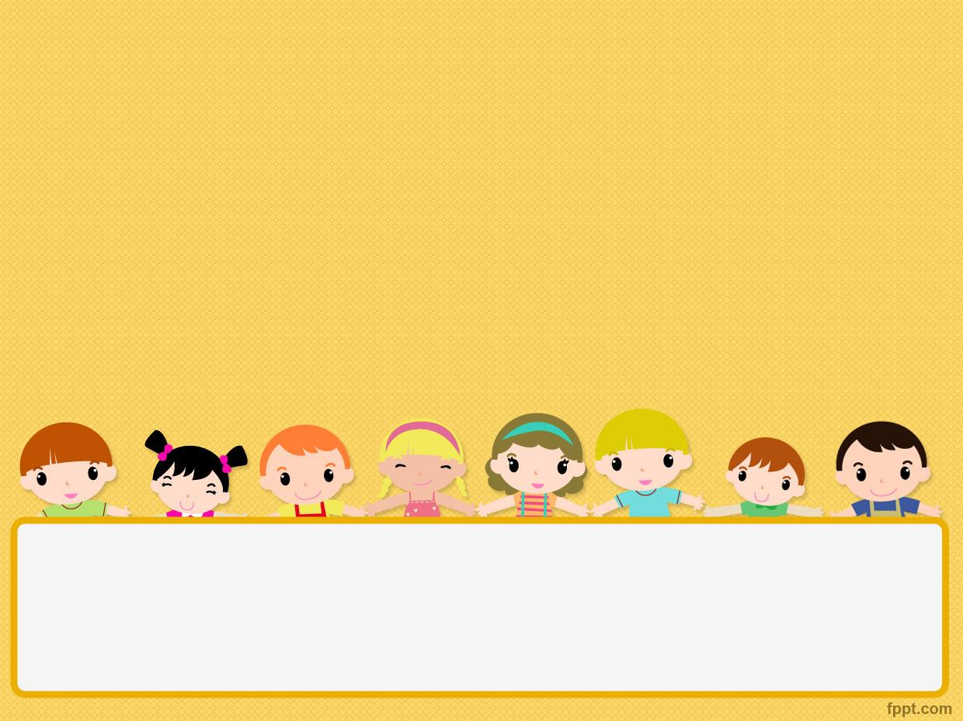
Song O-B-E-D-I-E-N-C-E

Slide 6

Obedience: Very best: Way: Show: Believe: Exactly: Commands Happily:

Slide 7

Action:
Key:
Immediately:
Joy:
Will receive:

Slide 8
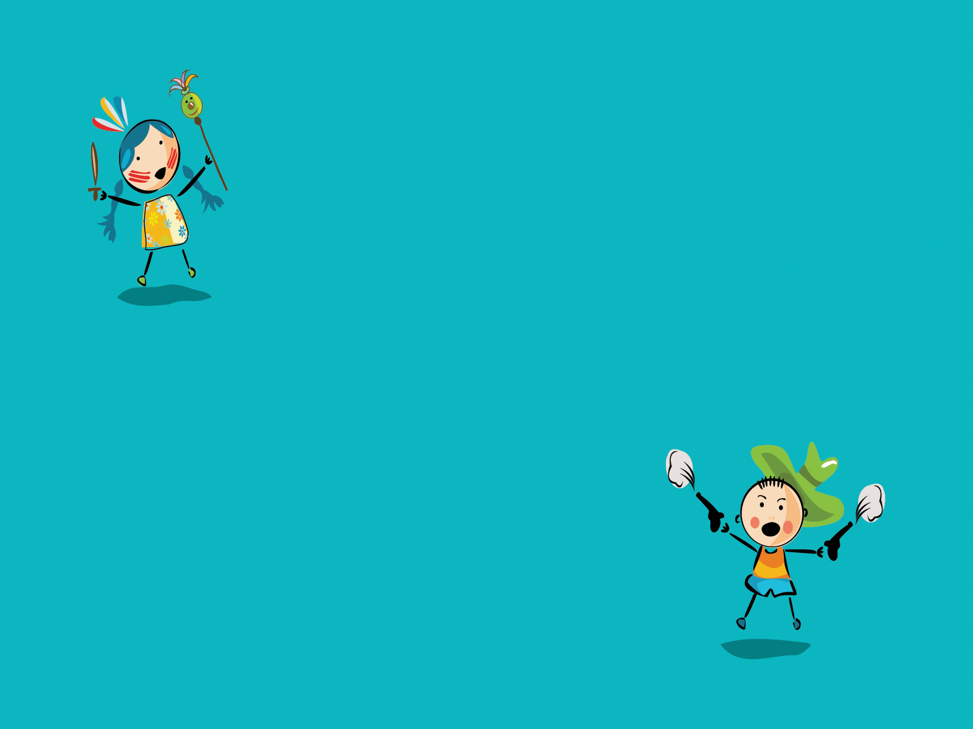
Obedience
is the very best way
To show that you believe
Doing exactly what the Lord commands
Doing it happily

Slide 9

Action is the key
do it immediately
Joy you will receive
Obedience
is the very best way
to show that you believe

Slide 10

O-B-E-D-I-E-N-C-E Obedience
is the very best way
to show that you believe

